Slide 1
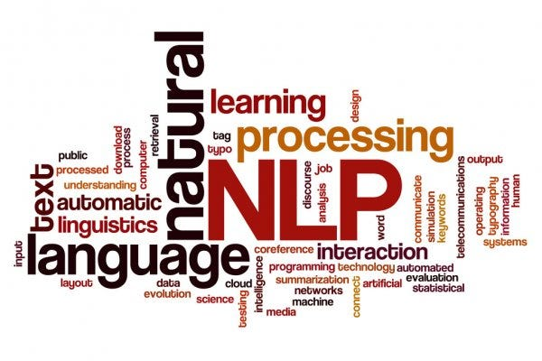
NLP Project for Disaster Tweet Classification

Slide 2
Purpose of the project
The challenge is to build a machine learning model capable of accurately classifying tweets as either related to real disasters or not. While some tweets may contain explicit keywords like "fire" or "flood," others may use such terms metaphorically or in a non-disaster context. Thus, the model needs to discern the true intent behind the language used in tweets, which can be nuanced and context-dependent.
Classification Model Development: Develop a machine learning model that can predict whether a tweet is about a real disaster or not.

Slide 3
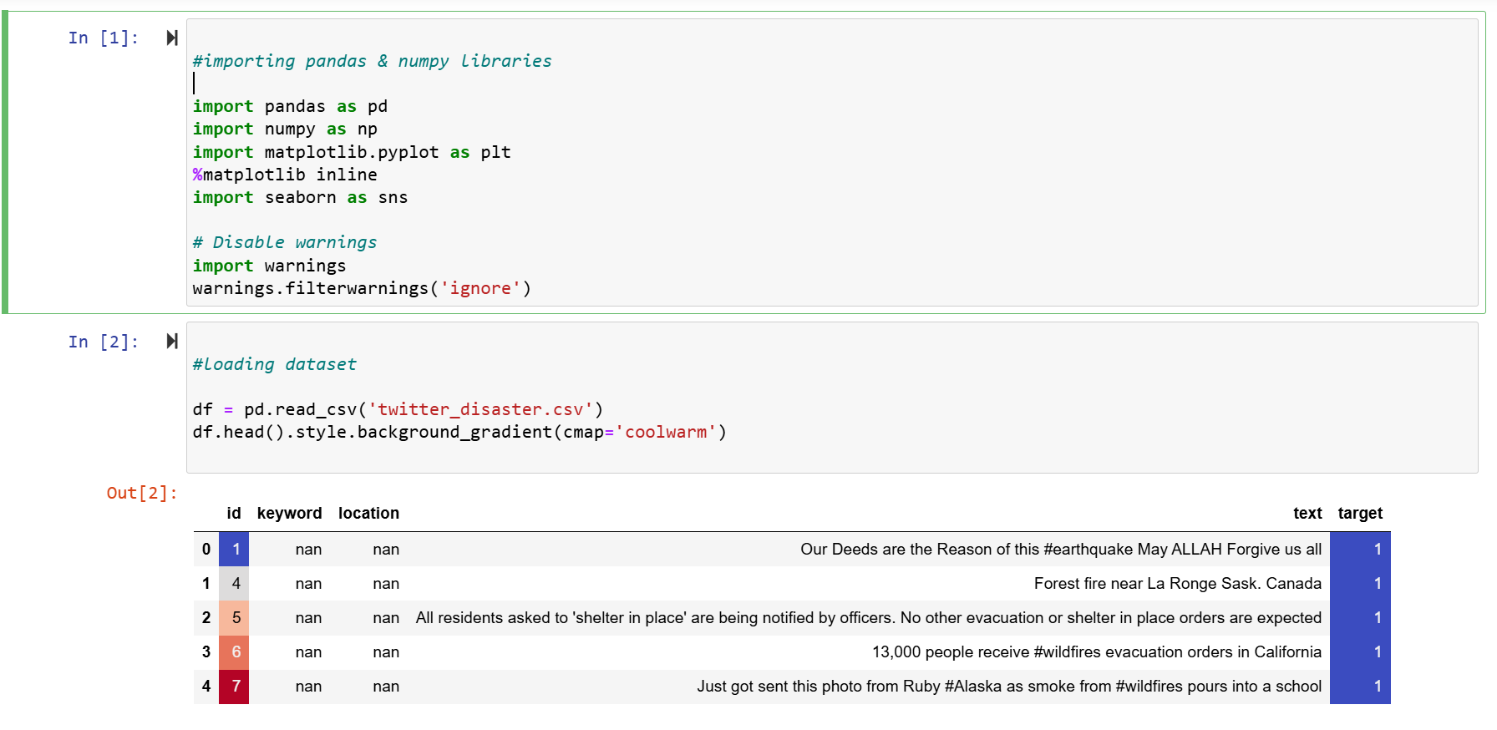
Data Exploration and Preparation

Slide 4
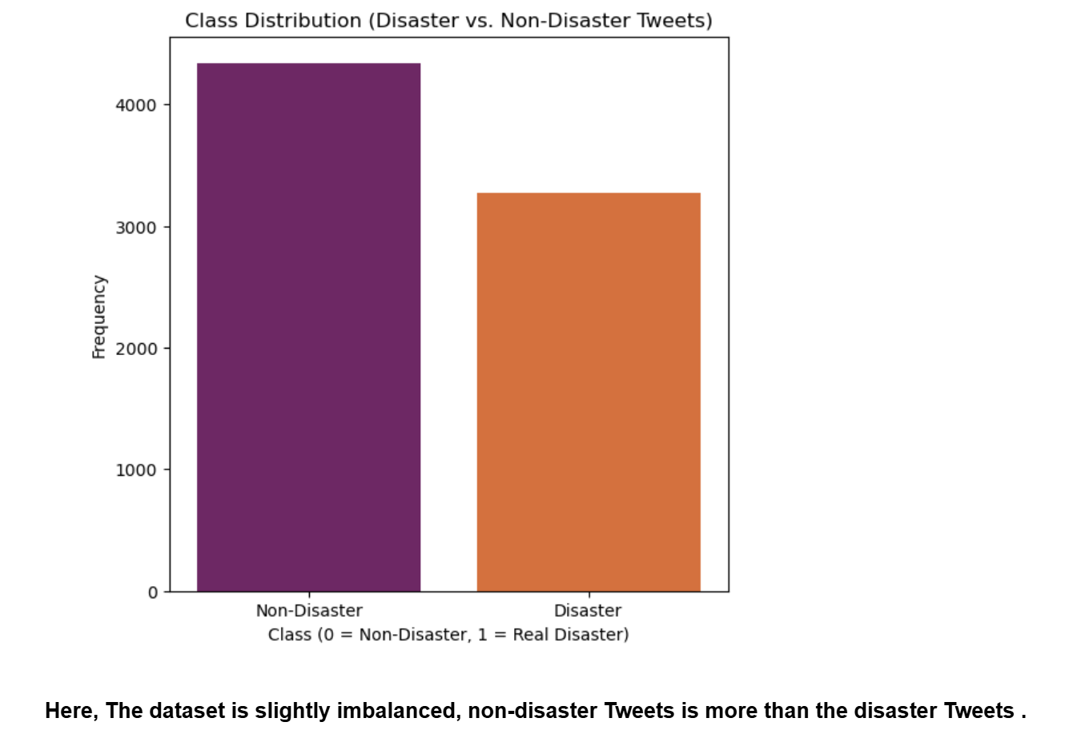
Visualize the distribution of classes (disaster vs. non-disaster tweets)

Slide 5
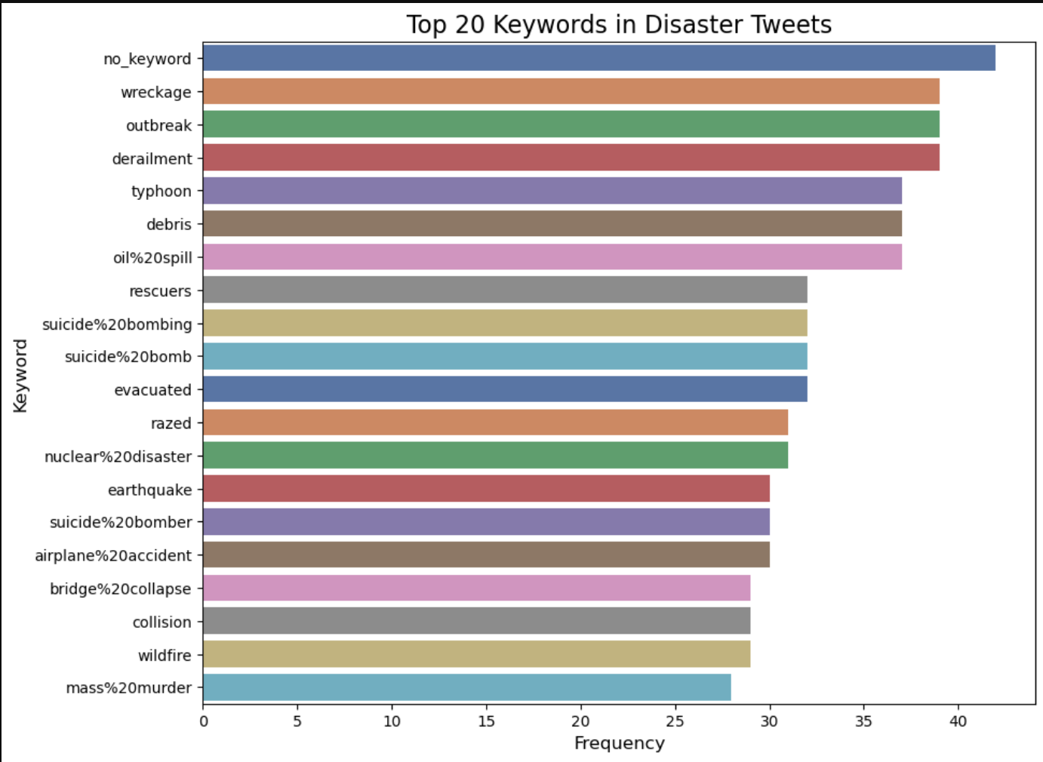
Analyze the frequency of keywords and phrases associated with disaster tweets.

Slide 6
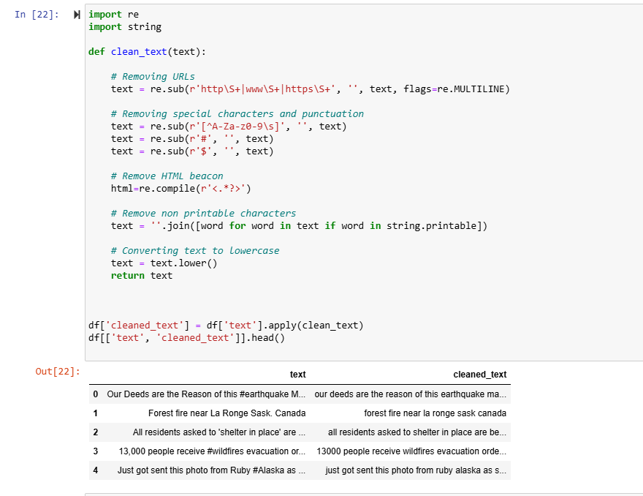
Clean the text data by removing special characters, URLs, and punctuation marks

Slide 7
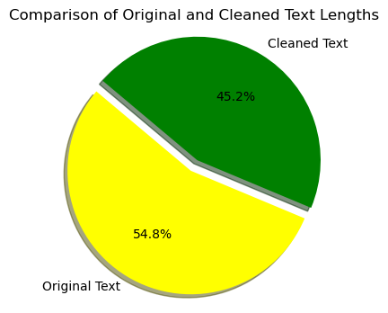
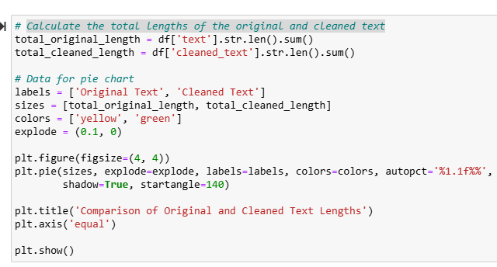
Calculate the total lengths of the original and cleaned text

Slide 8
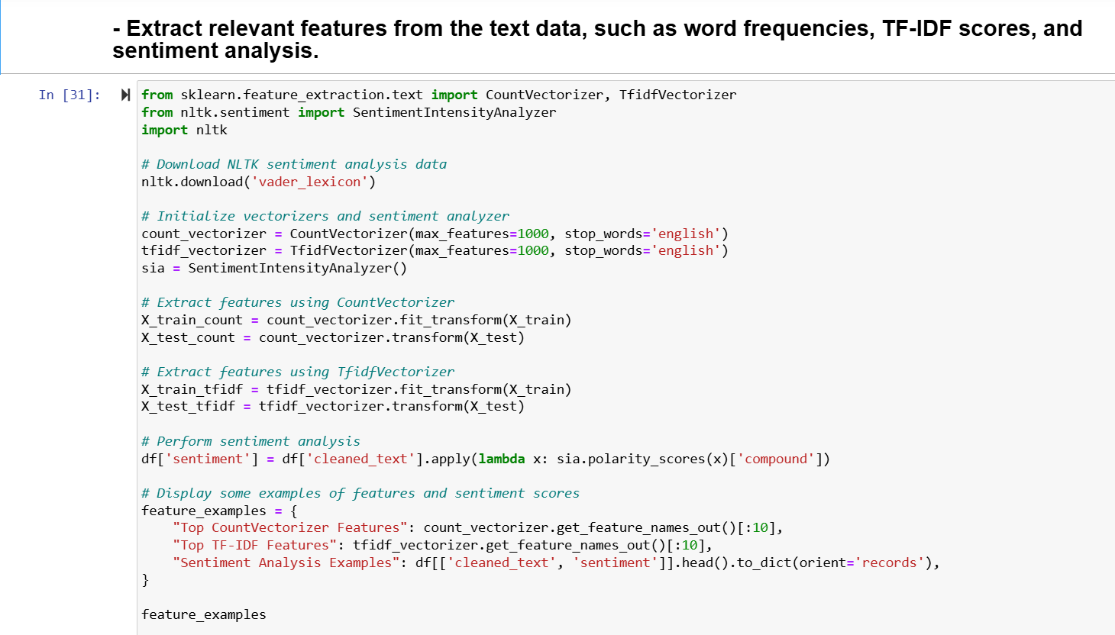
2. Feature Engineering and Model Selection

Slide 9
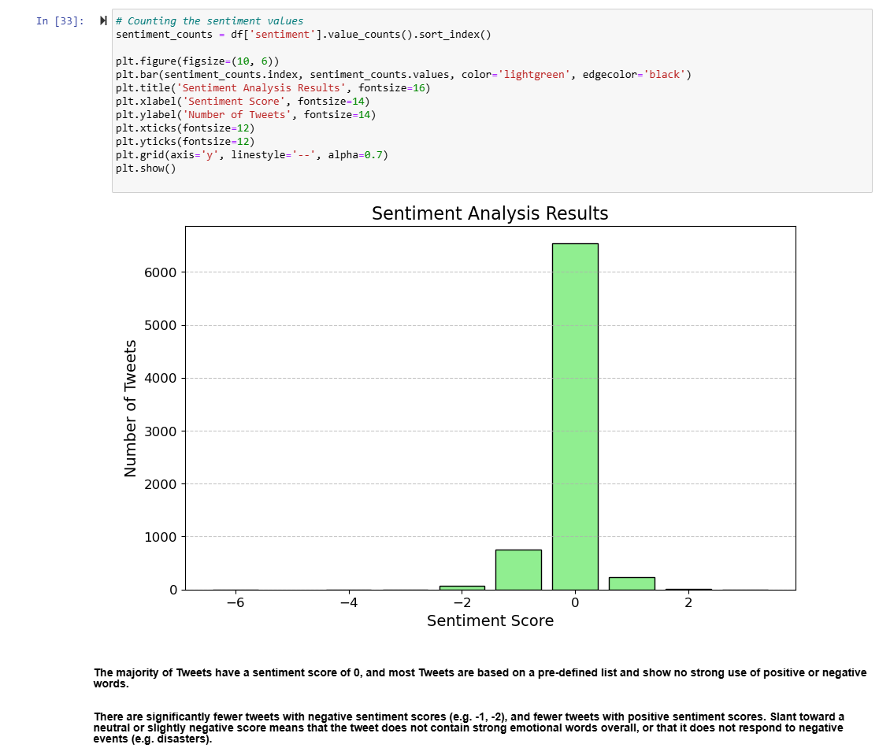
Sentiment Analysis

Slide 10
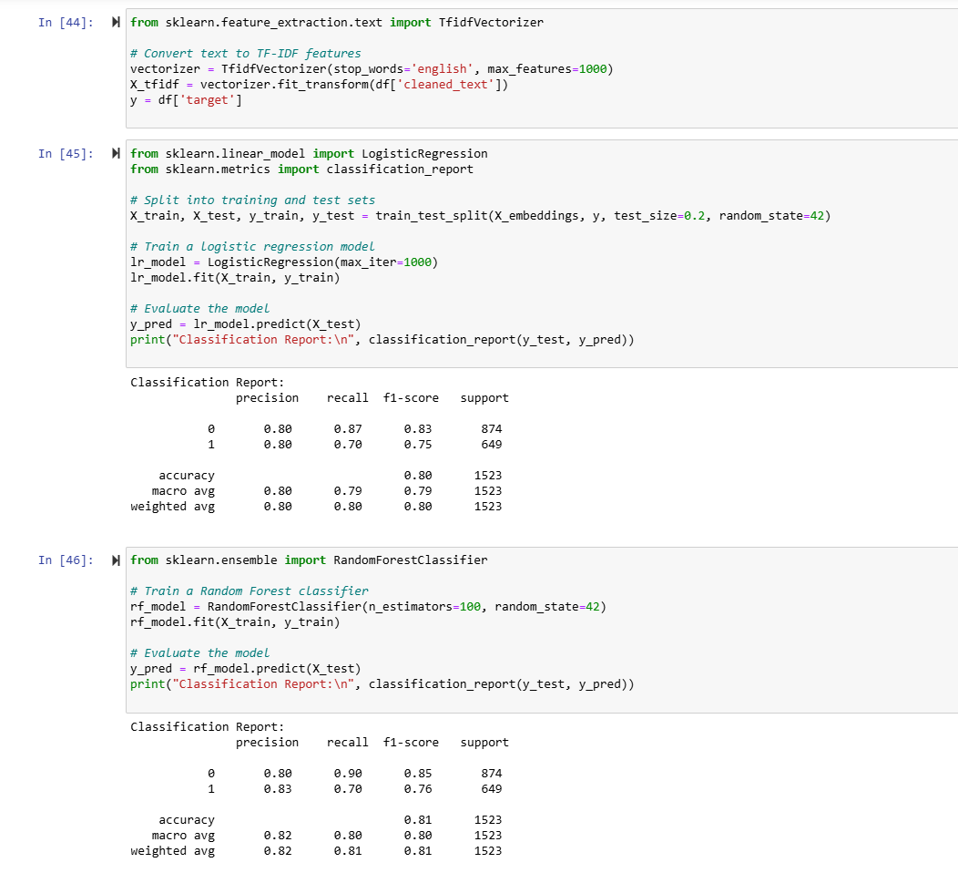
Choose a set of candidate classification models

Slide 11
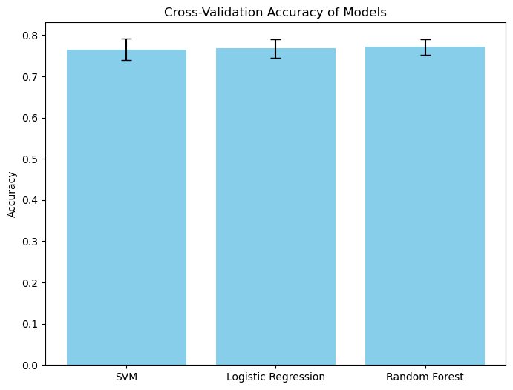
Evaluate performance using cross- validation techniques

Slide 12
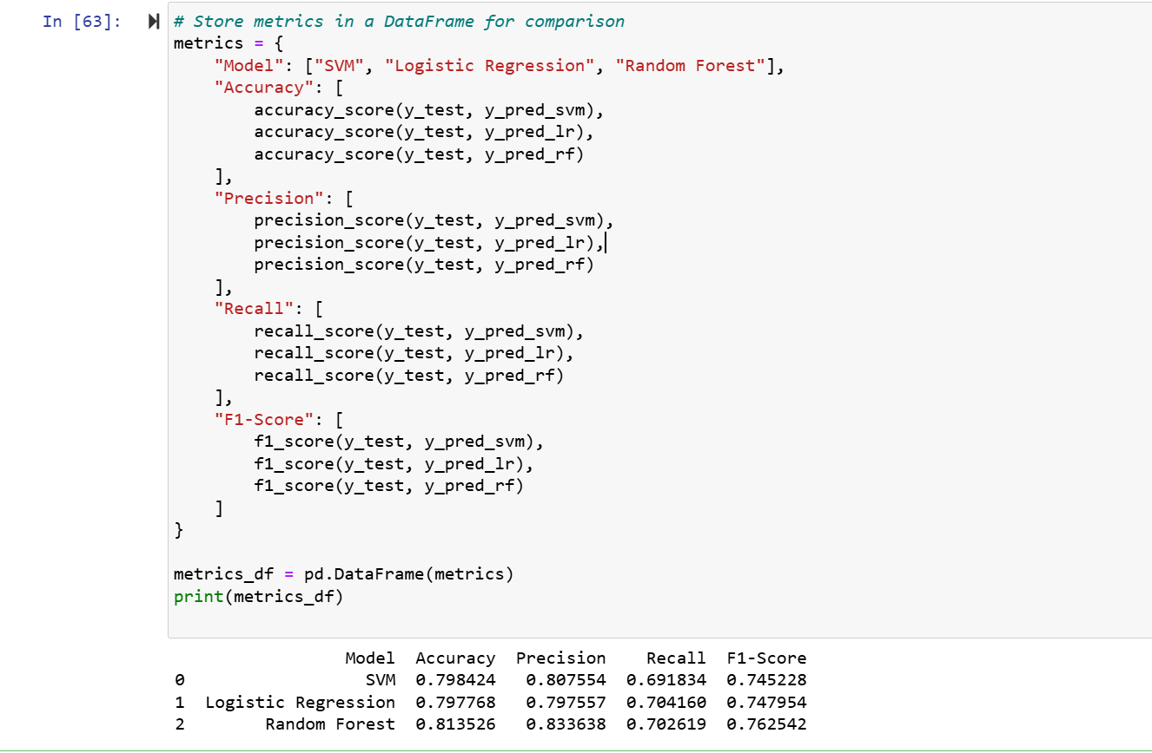
Model Evaluation and Validation

Slide 13
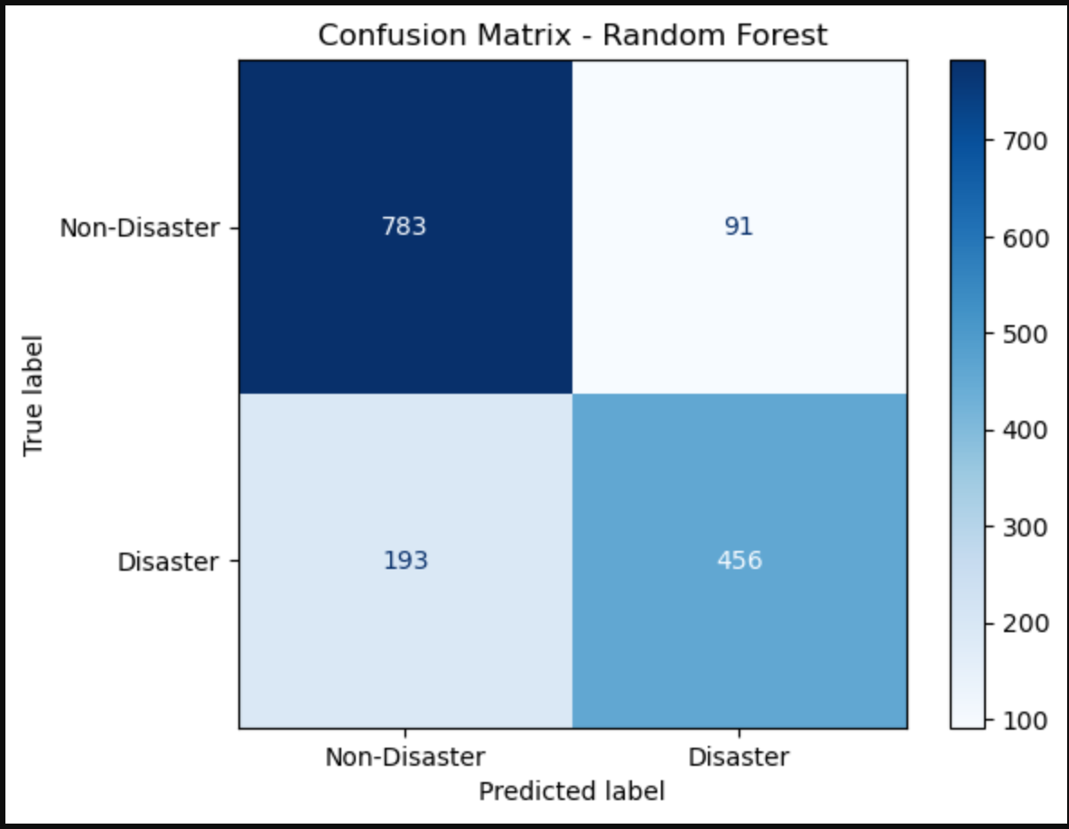
Confusion Matrix Analysis Random Forest Model Performance

Slide 14
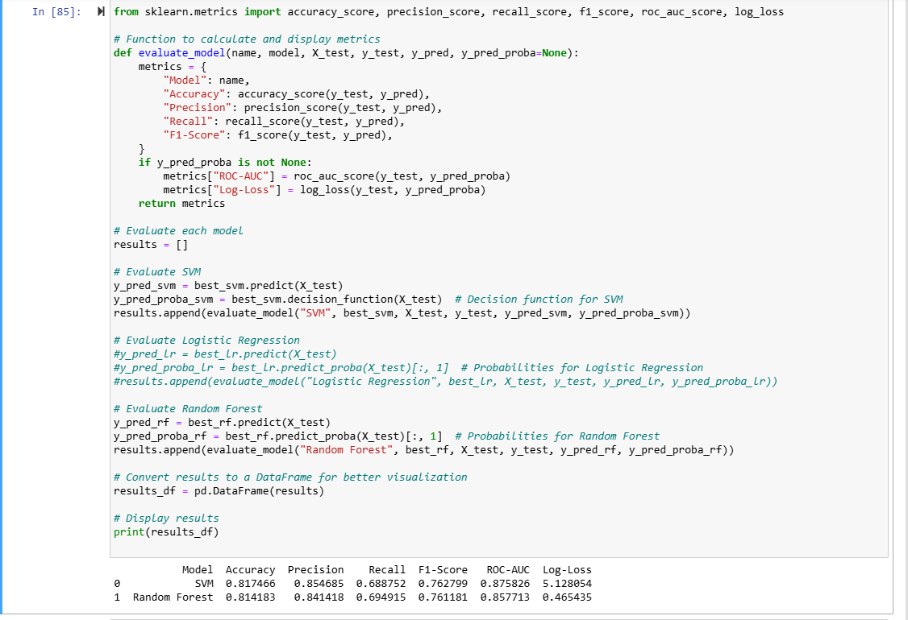
Compare the performance of different models

Slide 15
Conclusion
Observations:
True Positives (TP): 451 tweets were correctly classified as disasters.
True Negatives (TN): 789 tweets were correctly classified as non-disasters.
False Positives (FP): 85 tweets were incorrectly classified as disasters.
False Negatives (FN): 198 tweets were incorrectly classified as non-disasters.
Conclusion:
The Random Forest model shows a high accuracy in classifying tweets as disasters or non-disasters.
The model has a relatively low false positive rate, indicating that it is good at avoiding unnecessary alerts.

Slide 16


